Slide 1
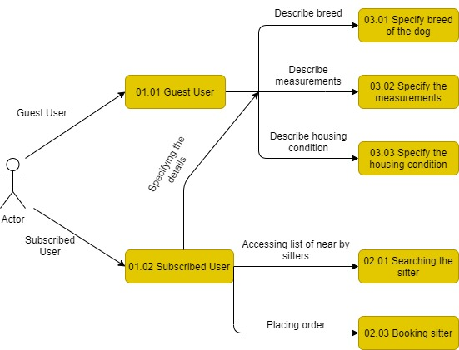
Data Flow Diagram- Logical

Slide 2
Pet-a-Dog
Data Flow Diagram (Physical)
Describe Breed
03.01 Specify the breed of the Dog
Dog’s details
Dog
Dog’s details
01.01
Guest User
Describe Measurement
03.02 Specify Measurement
Guest User
Booking Details
Specific booking details with extra message facility
Describe Housing
condition
03.03 Housing Condition
User
02.02
Booking Sitter
All the booking related details
Booking
Subscribed User
Placing appointment
02.01 Searching Sitter
Accessing list of nearby sitter
Sitter
Sitter details
01.02
Subscribed User
Location
User details
User

